Slide 1
Non Invasive Blood Sugar level Detector using Raspberry Pi
Niveditha M S- 4VP23EC025
Shravya M R -4VP23EC043
Sinchana M -4VP23EC045
Deeksha - 4VP23EC009

Slide 2
INTRODUCTION:
The Blood Sugar Level Detector Using Raspberry Pi aims to find the glucose level in the human body.
Mean-while having finger pricking to detect the blood sugar level in the human body which is painful , invasive method .
Here this project mainly focus on the blood sugar level detection by focusing laser(650nm) point to the fingertip whereas web-camera captures speckle pattern of the finger tip .
Here this speckle pattern mainly focus on the bright spots , And this image is converted into Gray-scale format , each pixel is given with bright specification values and mean of this is calculated .
According to formula [-0.4*mean_intensity+160] glucose level is calculated and detecting the diabetic or non-diabetic .

Slide 3
LITERATURE SURVEY:
Ramesh and A.K. propose an AI-driven healthcare model using Raspberry Pi to collect and analyze biomedical signals [2].
Their study shows machine-learning algorithms improve predictive accuracy by detecting patterns in sensor data [2].
They highlight the potential of AI with embedded platforms like Raspberry Pi for cost-effective, user-friendly health monitoring [2].
Islam and Ramesh & A.K. together demonstrate non-invasive, portable, intelligent glucose monitoring systems 1][2].
Their research shows optical sensing with AI analysis enables real-time health insights, advancing diabetic care solutions 1][2].

Slide 4
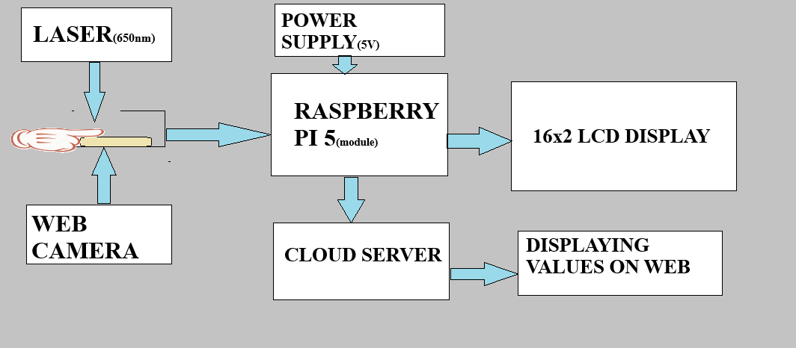
BLOCK DIAGRAM:

Slide 5
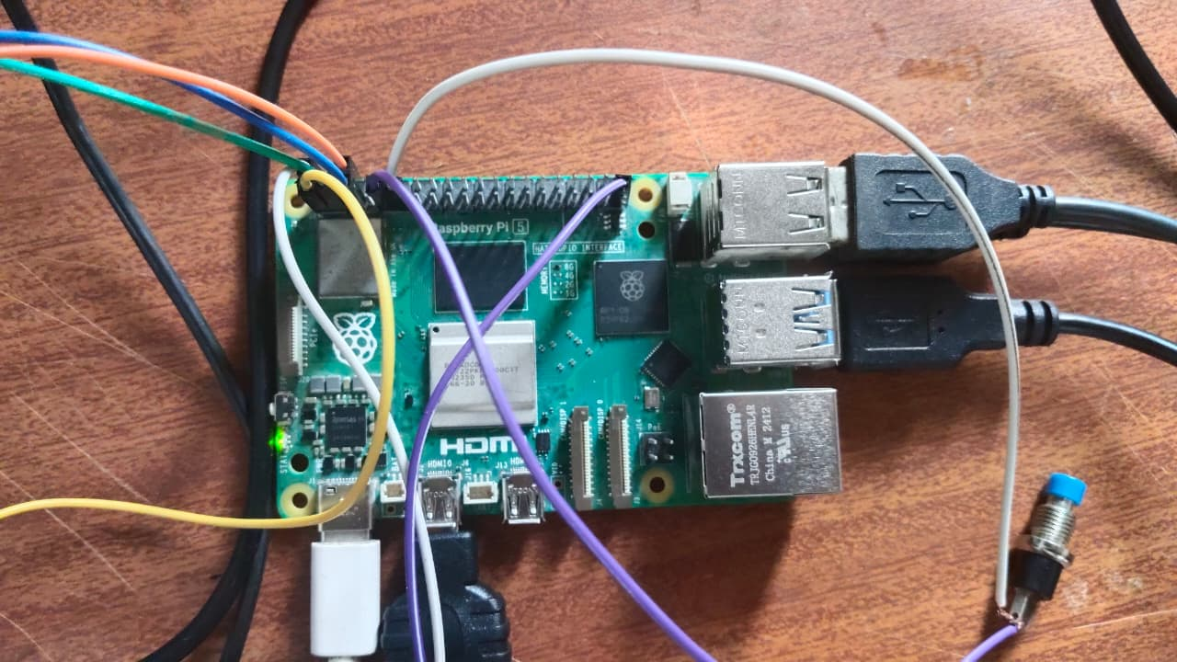
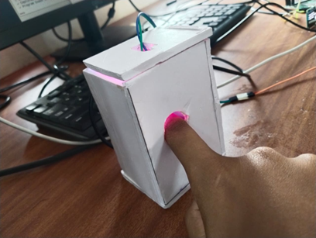
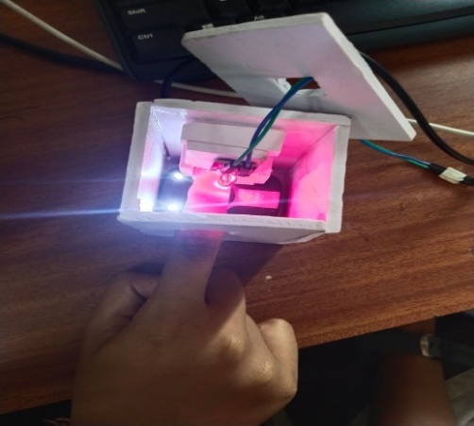
Data Acquistion :
Data acquisition refers to collecting the raw input required for glucose estimation by capturing a clear, well-lit image of the user’s fingertip using the Raspberry Pi camera.
When the user presses the button, the camera takes a high-quality image under controlled lighting, ensuring proper brightness and focus.
This image becomes the primary input for preprocessing, intensity calculation, and glucose prediction.
Accurate data acquisition is crucial because the quality of the captured image directly influences the reliability and consistency of the system’s results.

Slide 6
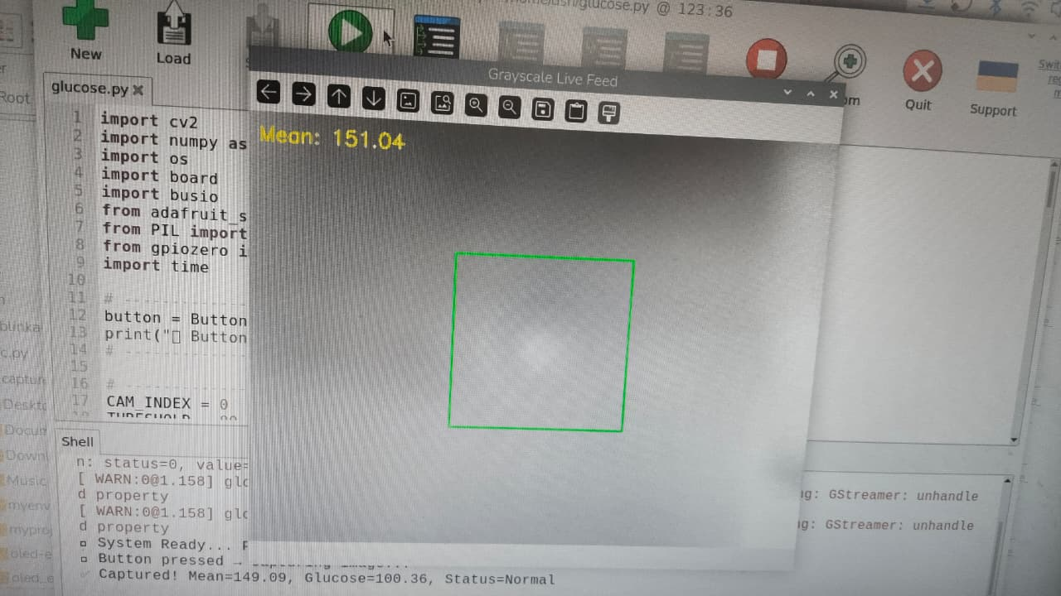
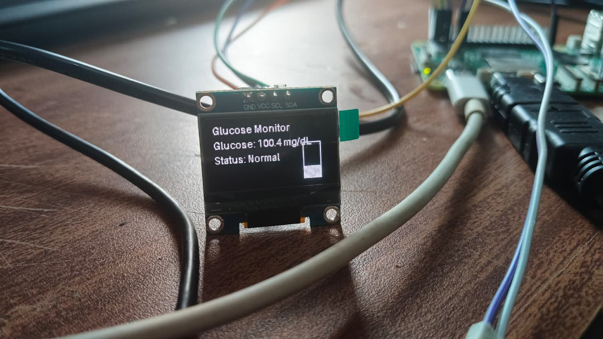
Data processing:
Data processing involves transforming the captured fingertip image into a usable form for glucose estimation.
After acquisition, the image is converted to grayscale, cropped to the Region of Interest (ROI), and filtered to remove noise.
The system then analyzes pixel intensity values and computes the mean brightness, which serves as the key feature for estimating glucose levels.
Efficient data processing ensures that the extracted information is clean, consistent, and ready for accurate analysis.

Slide 7
1.CollectReferenceSamples Capture several fingertip images and record each user’s actual glucose level using a glucometer. Each image must have a matching true measurement.
2.ExtractImageIntensities For every image, compute the mean grayscale intensity from the selected ROI. These intensity values act as the key calibration data.
3.BuildIntensity–Glucose Relationship Plot the recorded intensities against the actual glucose readings and fit a simple linear model: Glucose = -0.4 × (Mean Intensity) +160
4.CalculateCalibrationConstants Determine the values of a and b using regression so that the estimated glucose values closely match real measurements.
5.TestandAdjust Capture new images and compare the predicted results with actual values. Refine a and b if needed to improve accuracy.
6.StoreFinalModel Once the mapping is consistent, save the final calibrated equation in the Raspberry Pi program for real-time glucose estimation.

Slide 8
METHODOLOGY:
The system captures fingertip images under controlled lighting using a camera connected to the Raspberry Pi.
The images are pre processed to remove noise and extract the region of interest (ROI).
Key optical features like mean intensity and colour variation are analyzed using OpenCV and NumPy.
A calibration model then converts these optical parameters into estimated glucose levels, which are displayed on the OLED screen with the health status.
Optionally, readings can be stored locally or sent to the cloud. This approach provides a non-invasive, low-cost, and efficient solution for glucose monitoring.

Slide 9
ADVANTAGES:
Non-invasive method: No needles or blood sampling required, making it painless and user-friendly.
Low-cost setup: Uses affordable components like Raspberry Pi, camera module, and OLED display.
Portable and compact: Works without a PC, keyboard, or monitor.
Quick results: Provides glucose estimation within a few seconds.
Simple interface: Single-button operation makes it easy for anyone to use.
Automated startup: System boots and runs automatically after powering on.
Real-time image processing: Uses OpenCV for fast intensity analysis.

Slide 10
APPLICATION:
Preliminary glucose screening: Useful for early indication or rough estimation of glucose levels.
Educational projects: Ideal for learning image proessing , sensors, and Raspberry Pi integration.
Prototyping for health-tech devices: Can be a base model for future non-invasive glucose monitoring systems.
Research and experimentstion: Helps explore relationships between image intensity and physiological signals.
Portable health monitoring: Can be used in low-resource areas for demonstration or basic checks.

Slide 11
CONCLUSION:
This project demonstrates a non-invasive glucose estimation system using a Raspberry Pi, combining image capture, processing, intensity analysis, and OLED display output.
The device operates independently without a PC, using automated startup and a simple button interface for easy use. Its compact design makes it portable and user-friendly.
While not a medical-grade solution, the prototype shows that camera-based analysis can be used for basic glucose estimation and provides a strong base for future improvements in accuracy and performance.

Slide 12
REFERENCES:
https://ijcrt.org/papers/IJCRT25A4445.pdf
https://www.mdpi.com/2076-3417/9/15/3046

Slide 13
Thank you

